Slide 1
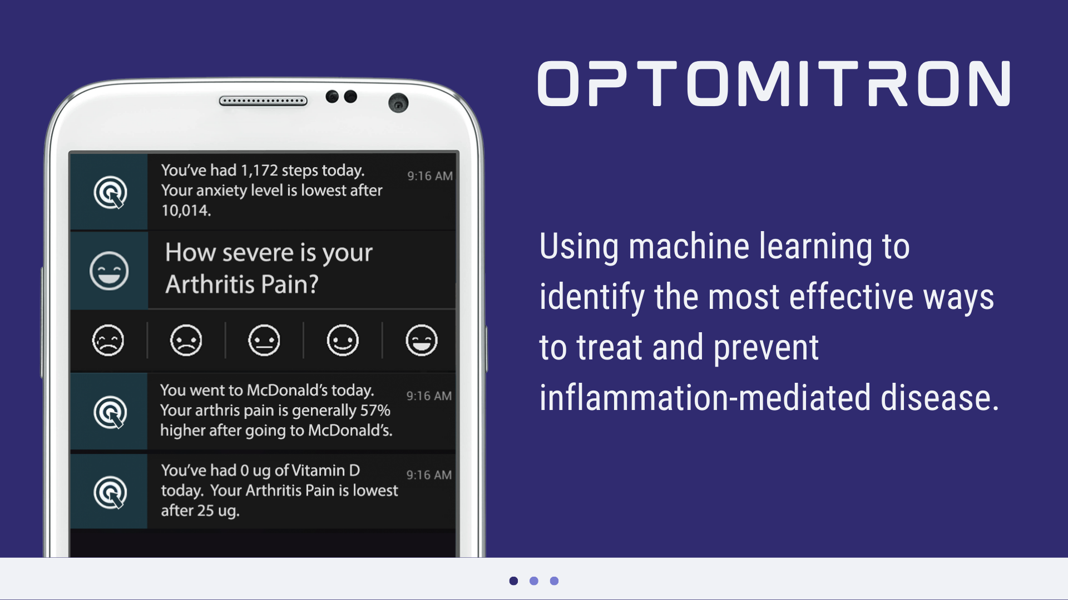
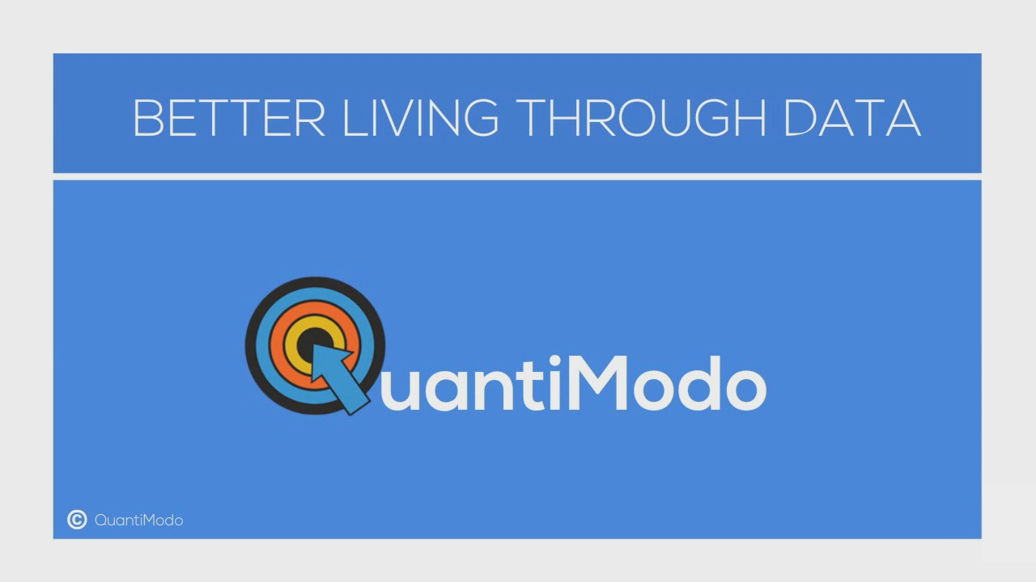

A BETTER WORLD THROUGH DATA
A platform aggregating and analyzing life-tracking data to find hidden causes of and new treatments for chronic illness.
Notes:
Optomitron aggregates and analyzes data to

Slide 2
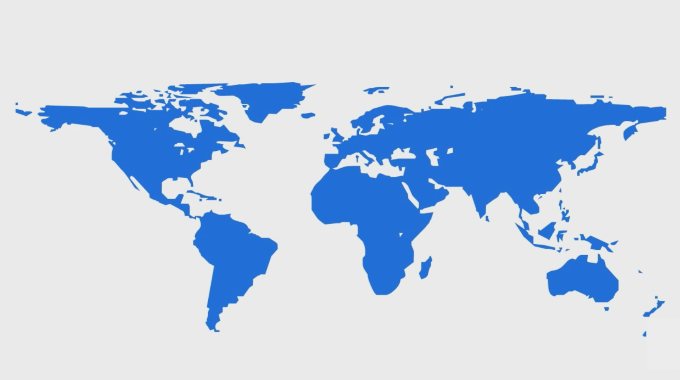
A BILLION PEOPLE SUFFER FROM INFLAMMATION MEDIATED DISEASES
Arthritis
Type 1 Diabetes
Mental Illness
479 million sufferers
Bipolar Disorder
Autoimmune Diseases
448 million sufferers
Crohn’s Disease
Alzheimer’s Disease
Depression
Multiple Sclerosis
Fibromyalgia
Anxiety Disorder
Notes:
A half-billion are suffering [pause here] from autoimmune diseases like Crone's disease, psoriasis, and Fibromyalgia.
Since there’s also a great deal of mounting evidence that treatment-resistant depression mental and other mental illnesses are strongly related to immunodysregulation.
So what all these diseases have in common…

Slide 3
















The immune system is influenced by hundreds of factors.
Diet
Social
Symptom Severity
Sleep
Exercise
Treatments
Environment
Notes:
...is that they can be exacerbated or improved by hundreds of factors in daily life like
Probably the most significant is the 3 pounds of thousands of unresearched chemicals that we consume every day through our diets.
And the since the thousands of chemicals in our food have been GRAS or “Generally recognized as safe” by the FDA, there’s no incentive to do research.
How much sleep did I get?
What medications did I take?
How much sugar did I consume?
How much gluten did I consume?
gluten intake,
Sugar,
diet,
sleep,
exercise,
social interaction,
and even the weather.
Unfortunately, the human mind is only capable of holding 7 numbers in working memory at a time.
Exclude recommended daily allowance
Brains don’t have the bandwidth or statistical processing power required to analyze the massive amount of longitudinal data, time delays, and durations of action that has to be taken into account if we are to determine the likely influence of each of these factors on the individual’s symptoms.
So we built QuantiModo to aggregate and analyze this data to determine which of these hundreds of factors have the strongest relationships the symptom or outcome of interest.

Slide 4
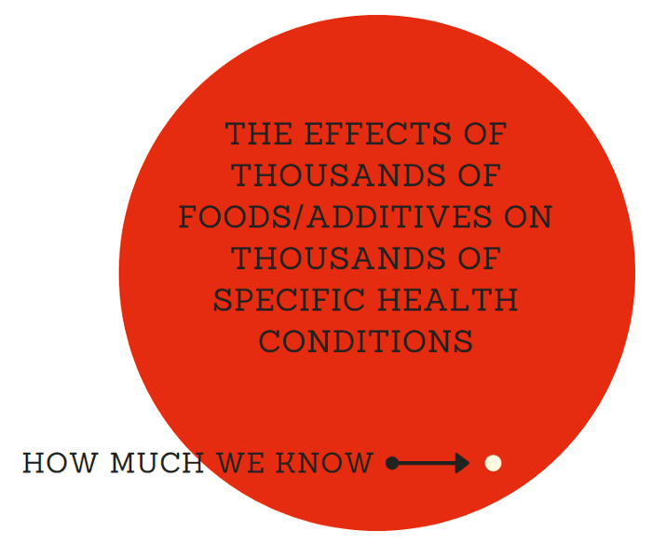

Slide 5
Why is this necessary?
Notes:
So there are already hundreds of thousands of apps and dozens of decentralized research and digital health platforms. So why do we need yet another one?

Slide 6
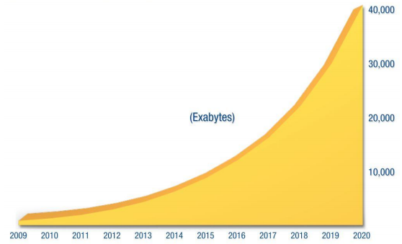

We’ve Seen a 50X Growth in Health Data Over the Past 10 Years
And the creation of 350,000 digital health apps

Slide 7
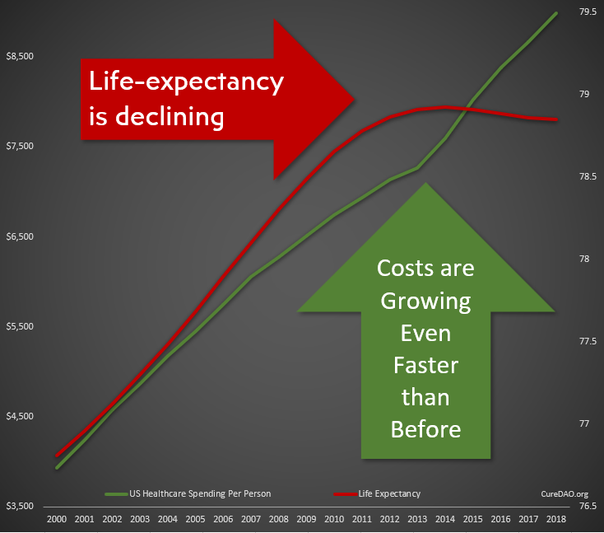
Yet All of This Innovation and Data has Failed to Improve Lifespan or the Cost Burden of Chronic Disease

Slide 8
Problem: Collaboration & Data Sharing
is Punished by the Market
We’ve wasted $157 billion paying over 350,000 programmers to write the same code to implement the same basic functionality.
Horizontal Stagnation
Notes:
The free-rider problem and the tragedy of the commons punishes any individual company that open sources it’s code

Slide 9
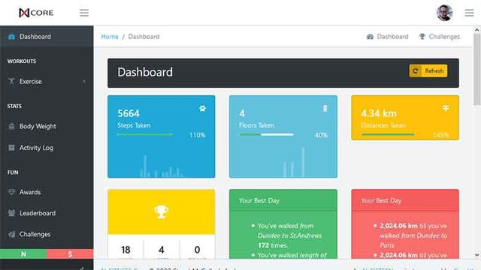
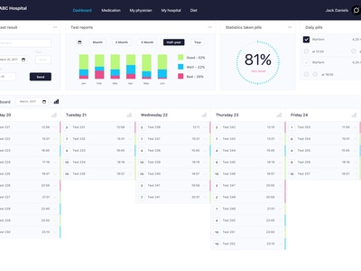
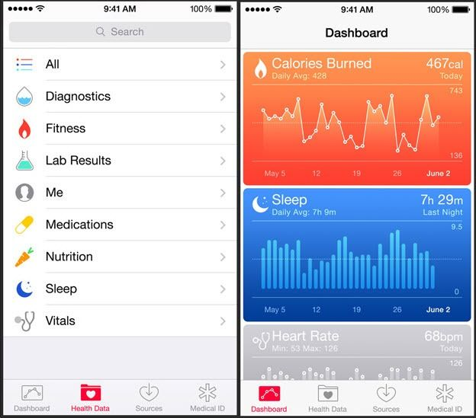
Result: Thousands of Dashboards
Nearly all apps allow you to provide data and show you what you have done rather than what you should do to prevent or treat disease.

Slide 10

Solution: Incentivize Open-Source Collaboration
We can utilize a DAO as a vehicle to reward the creation of public goods.
This allows everyone to stand on everyone’s shoulders, massively accelerating progress.
Vertical Innovation

Slide 11
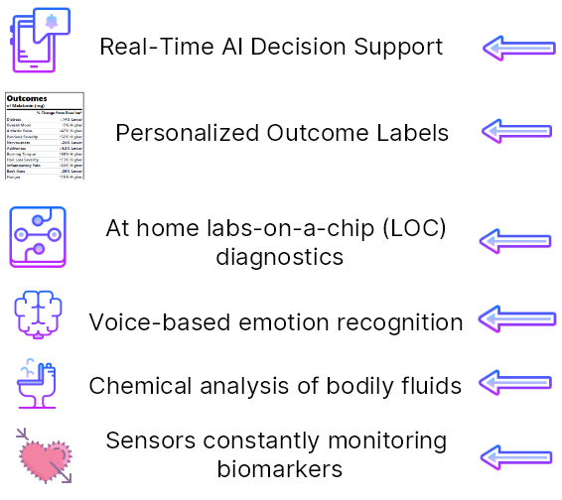
Vertical Innovation
How We Could Be
Spending that
$157 Billion
Notes:
on every medication, food, and nutritional supplement showing the change from baseline for symtoms or disease risk and providing a cost-benefit analysis weighing personal health risk/benfit ratios against the cost of the product.

Slide 12
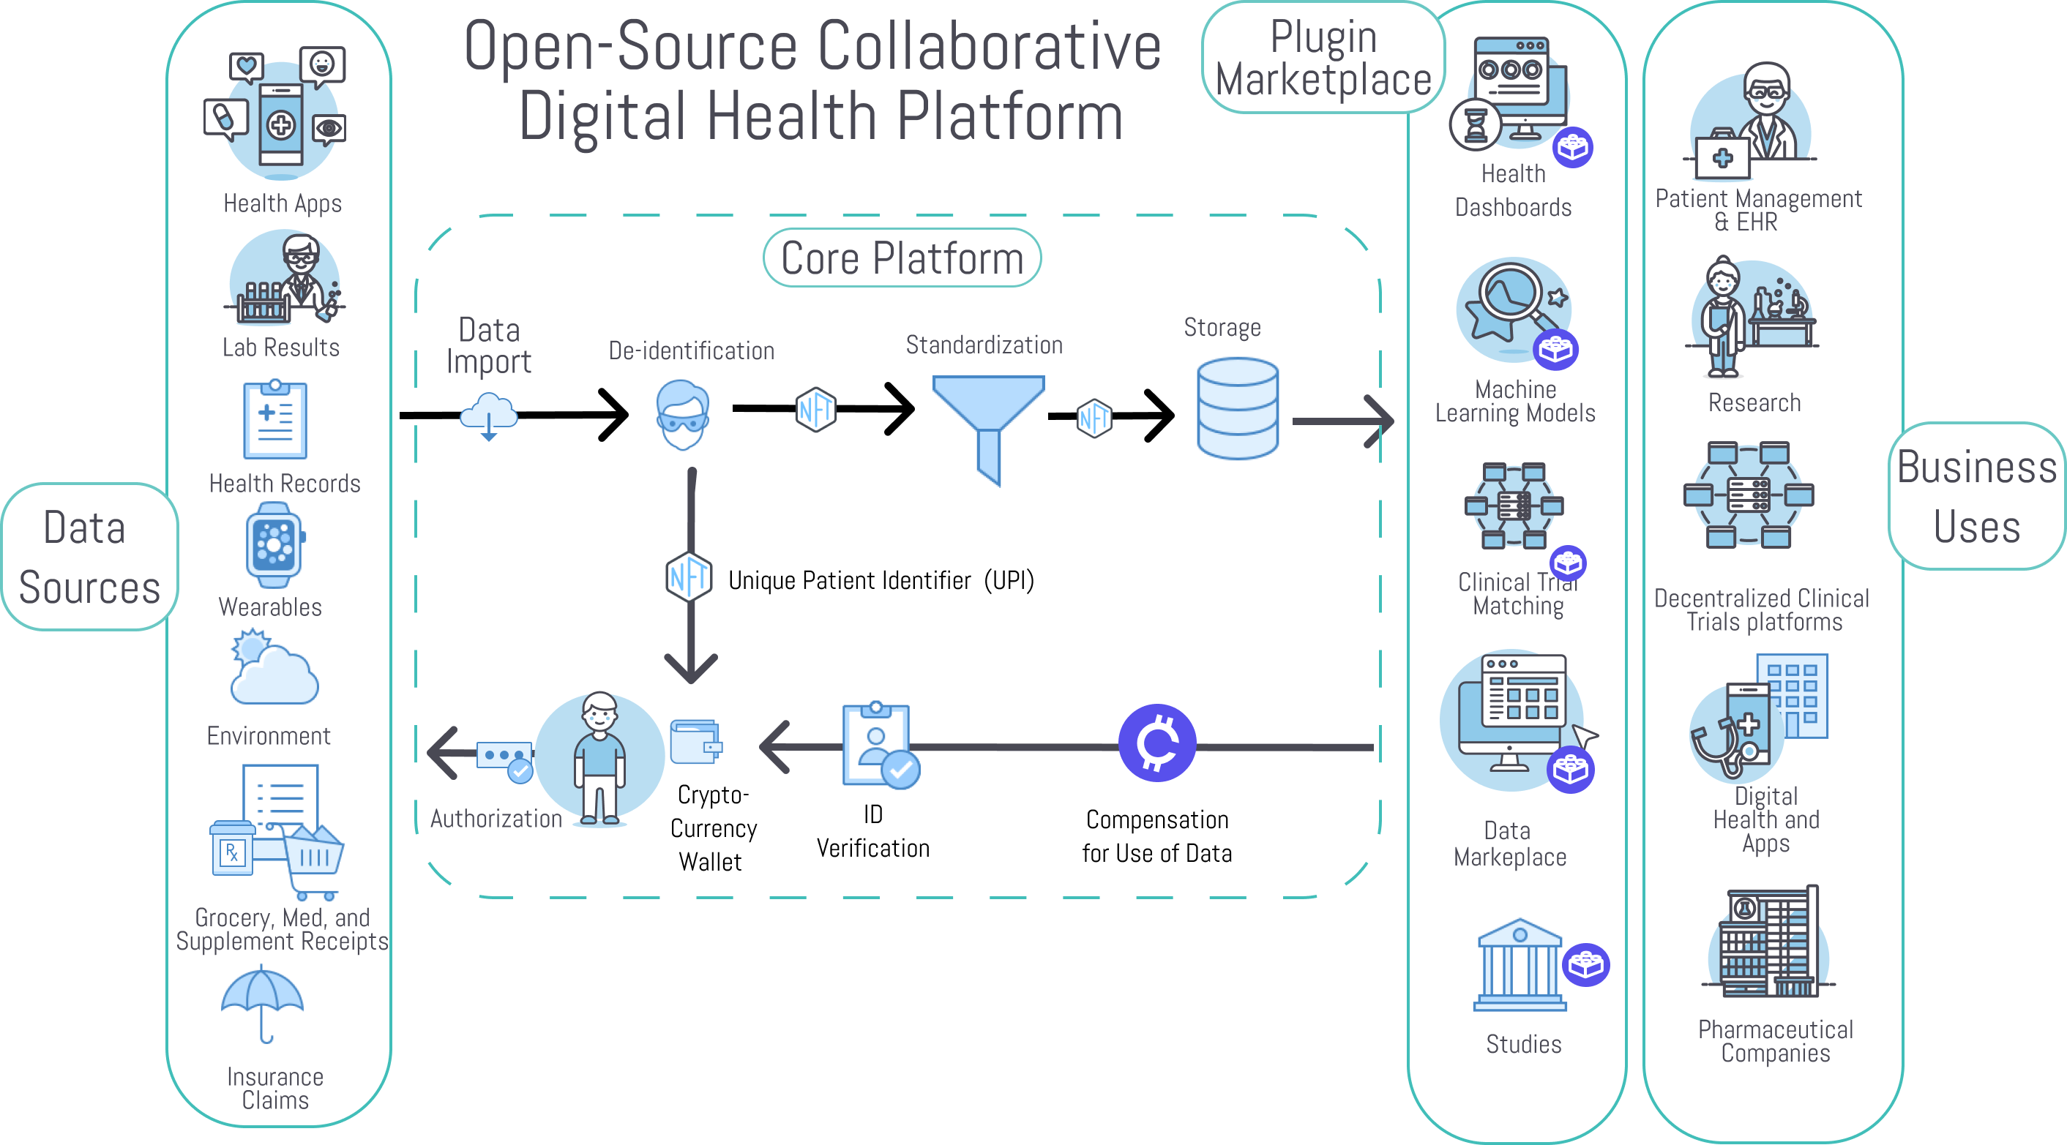

Slide 13
















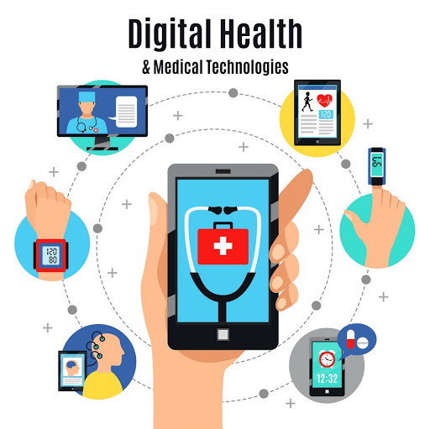



How to Incentivize Collaboration
and Data Sharing
Reduced R&D Costs Through Decentralized Clinical Trial Platform
Grants
Drug Companies
International Regulatory Epidemiological Natural Experiments
Deidentified Data for Drug Discovery
Reduce Exploding Healthcare Costs
De-identified Data Contribution
Personalized Recommendations for Prevention and Treatment of Disease
Reduce Health Agency Development Costs
Individuals
Open-Source Decentralized Clinical Trial Platform
Government
Ongoing NFT Royalties
Reduce Healthcare Expenditure by Facilitating Preventative Discoveries
Supplement Receipt Data
Code, Content and IP Contribution
Grocery Receipt Data
Facilitate De-identified User Data Sharing
Promote Research and Member Engagement More Productive Than Charity Walks
Promotion of Studies
Medication Data
Reduced Development Costs Through Use of White-Label Use of Platform
Software or Data
Ongoing Royalties from NFT
EHR
Developers and Contributors
Insurance Data
Disease Advocacy Non-Profits
Corporate Data Silos
Digital Health Businesses
Notes:
Should be at 6:00 here
Limit to
Leave numbers out of dictation
Introduce Renato – 1:45
Who Will Pay, 6 segments
Developers
There are 97,000 health apps which can save months of development time and tens of thousands of dollars by using our platform instead of reinventing the wheel.
Researchers
It currently costs $48k per subject in a phase 3 clinical trial. Instead of spending months gathering data, we create a shareable url that researchers can share with participants to authorize access to pre-existing data in quantities never seen before.
Patients
Using our client apps and browser extensions, patients can easily track their symptoms, import data from other sources, and discover hidden dietary, behavioral, and environmental factors that could be exacerbating or improving their symptoms.
Health Insurers
Furthermore, this new digital health solution would help to drive down cost for insurance providers. Health plan providers need a more personalized approach to help their members and have found a way to do so with provider-and patient-reported digital health data. By incorporating this data into a centralized repository, payers can analyze and use this information to create and improve their various member services. For example, in addition to supporting patient-specific care-management models, integrated data could enable the creation of wellness programs, preventive or disease-management care initiatives or even health-coaching programs. This personalized data can go beyond incentivizing and motivating healthy lifestyles; it can also help payers increase member engagement, a critical objective for many health plan providers.
Pharmaceutical Companies
106,000 people die annually in the U.S. from properly prescribed drugs. The number of people having in-hospital, adverse reactions to prescribed drugs to be 2.2 million per year. The total number of deaths caused by conventional medicine is 783,936 per year. Pharmaceutical companies spend over $2 billion a year on over 314,000 events attended by doctors.
Initial sponsor applications will be focused on tracking adverse reactions to the medications known to produce the most adverse reactions. MEDTLC, QuantiModo’s treatment and symptom tracking application would reduce the number of deaths and costs of intervention by alerting patients and their practitioners to conditions before they become irreversible. Additionally, the opportunity to meet and promote these applications to physicians would also serve as a novel new way for pharmaceutical manufacturers to connect with physicians.
Healthcare Providers
A dashboard visualizing all factors in a patient’s health can then help doctors formulate an informed care plan.

Slide 14
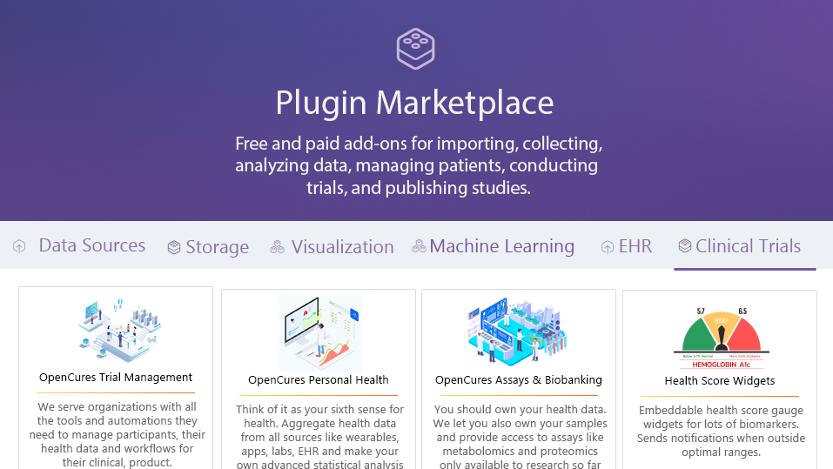
Notes:
For every disease, and many interventions there is an app and they continue to grow. The user interfaces tailor to focus on that disease but they require the same basic core infrastructure.

Slide 15
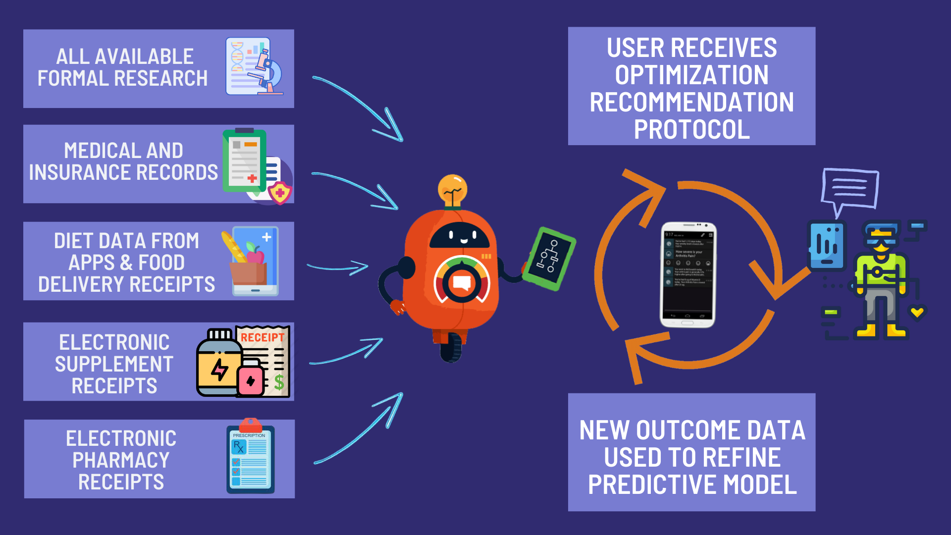

Slide 16
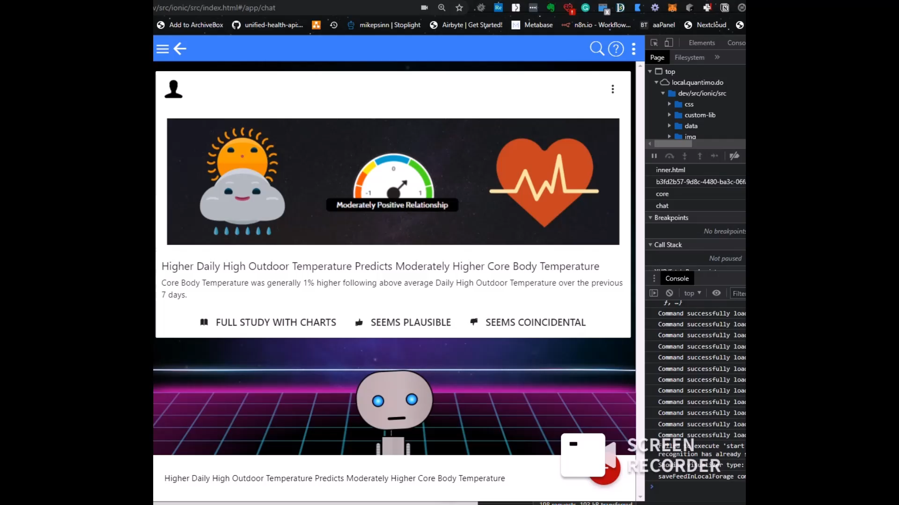

Slide 17
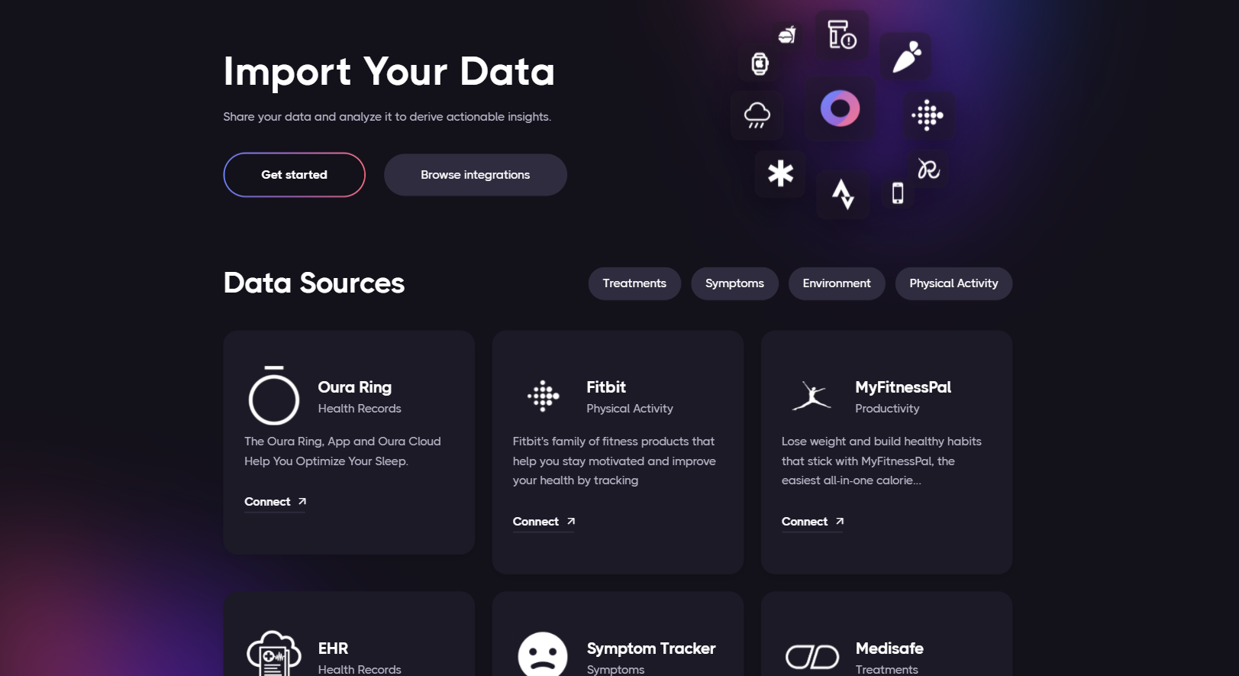
OptomITRON

Slide 18
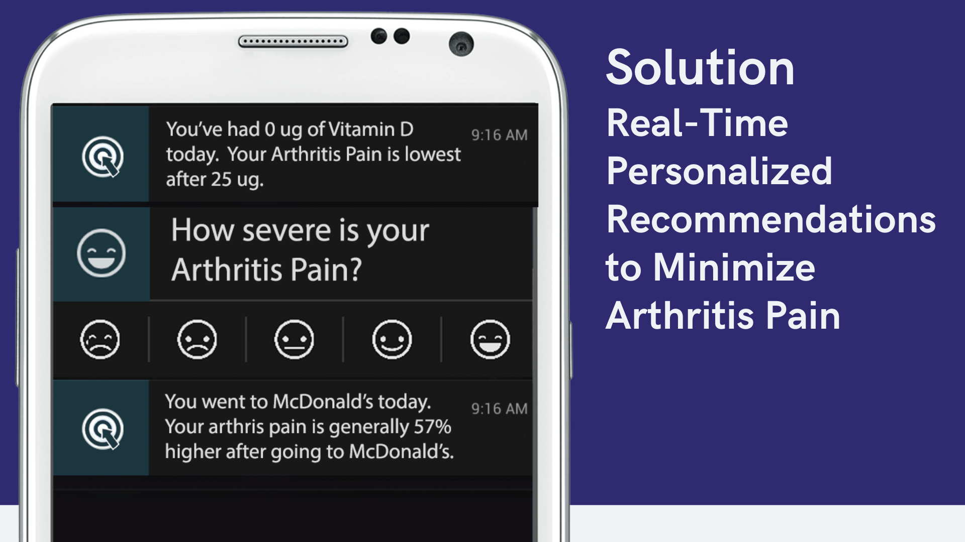

Slide 19
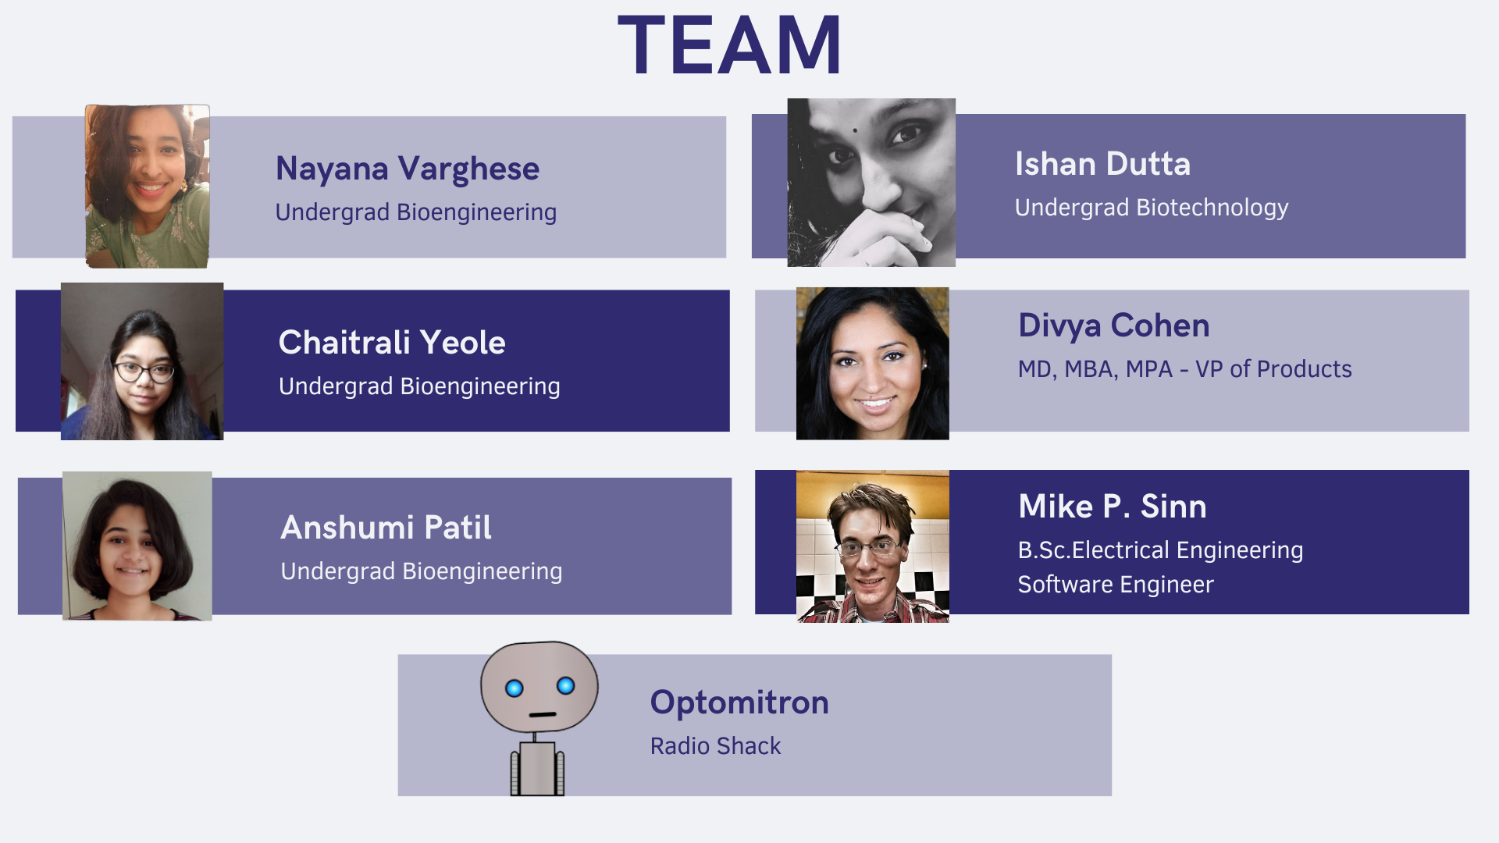

Slide 20

THE END

Slide 21
Appendix
Notes:
So there are already hundreds of thousands of apps and dozens of decentralized research and digital health platforms. So why do we need yet another one?

Slide 22
Analysis Notes for Reference
Notes:
So there are already hundreds of thousands of apps and dozens of decentralized research and digital health platforms. So why do we need yet another one?

Slide 23
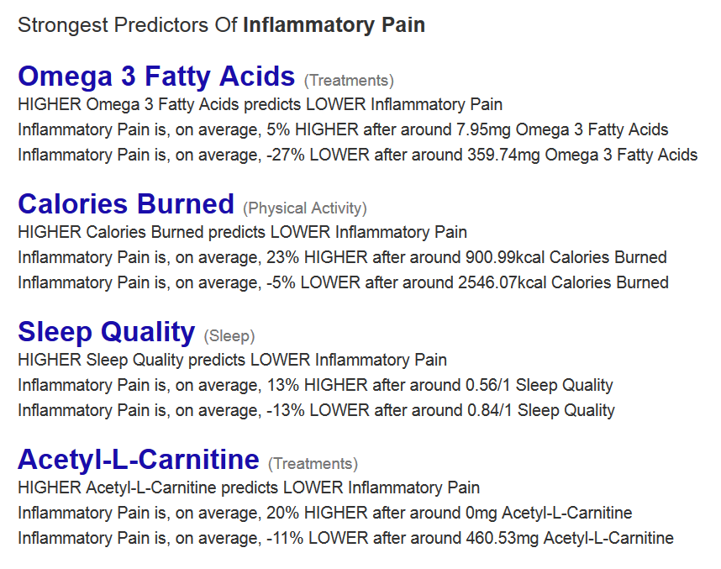
Notes:
Name all 4 quickly
And finally, this enables the user to select any symptom or outcome of interest and then see which factors are most predictive of that outcome. Here we see the top factors most predictive of reduced inflammatory pain. The strongest predictor is Omega 3 Fatty acids that this says that my inflammatory pain is typically 27% lower after I take 400mg of inflammatory pain.

Slide 24
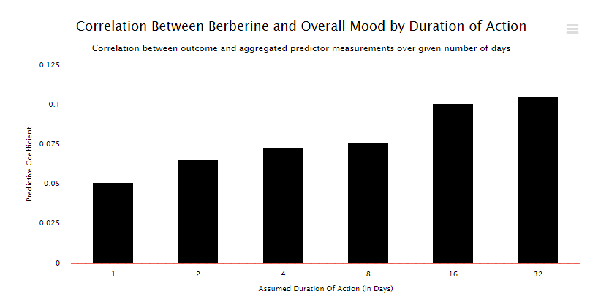

Slide 25
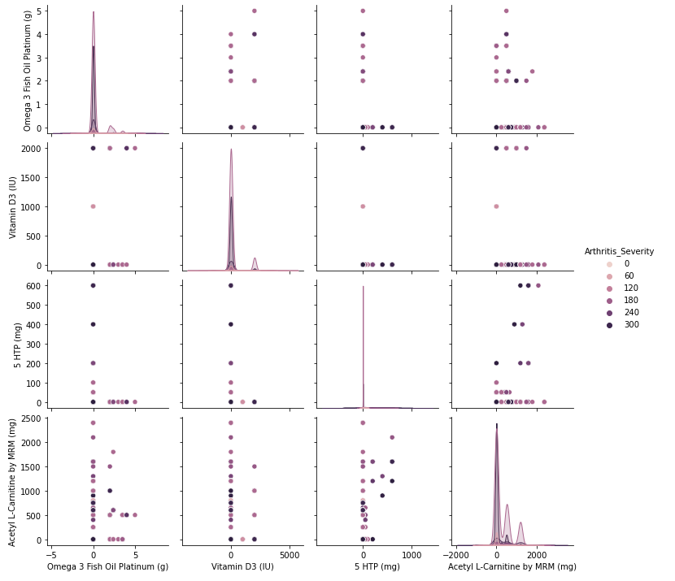

Slide 26
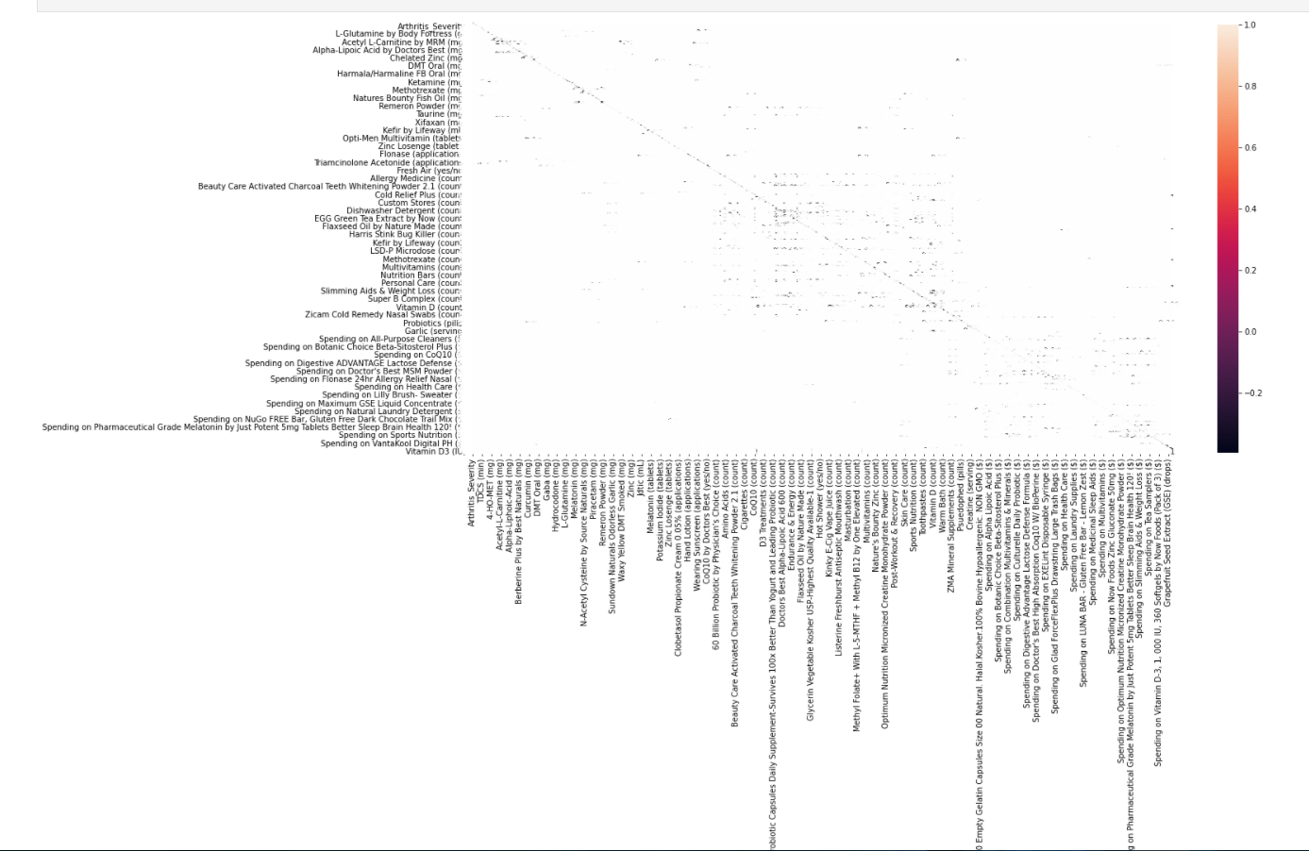
Heatmap: to visualize relationship of the value with the dataframe

Slide 27
Modeling With Selected Features.
we evaluated a Logistic Regression model with all features compared to a model built from features selected by ANOVA f-test
The model achieves a classification accuracy of about 99.74 percent.
Model Built Using ANOVA f-test Features gave an accuracy of 99.74 percent.
We evaluated the model configurations on classification tasks using repeated stratified k-fold cross-validation. We will use three repeats of 10-fold cross-validation via the RepeatedStratifiedKFold class.
Best Mean Accuracy: 0.999 Best Config: {'anova__k': 6} Plotting the results using box and whisker plots side-by-side.

Slide 28
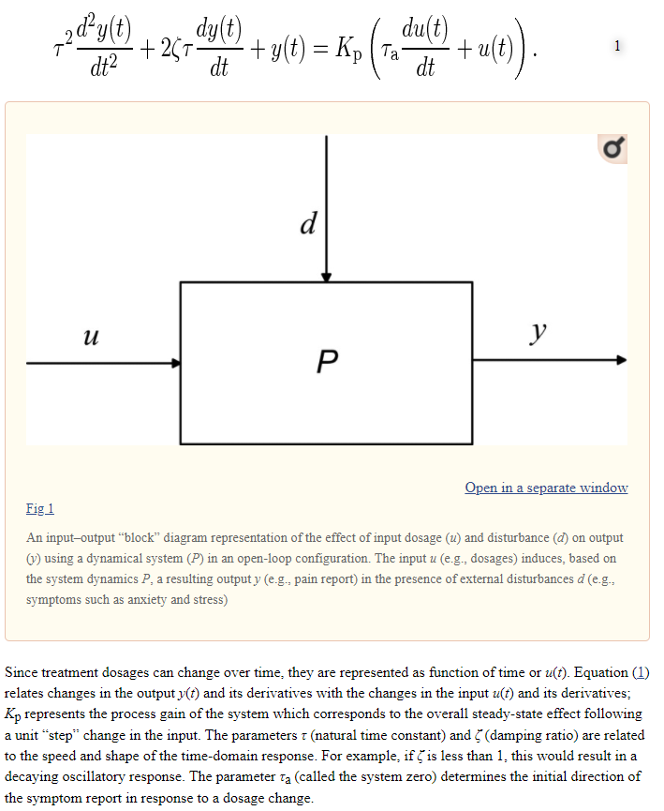
A control systems engineering approach for adaptive behavioral interventions: illustration with a fibromyalgia intervention (nih.gov)
Notes:
At this time, we apply coefficients representative of each of [Hill’s criteria for causation](http://www.drabruzzi.com/hills\_criteria\_of\_causation.htm) to quantify the likelihood of a causal relationship between two measures as: * _**Strength Coefficient**_: A relationship is more likely to be causal if the correlation coefficient is large and statistically significant. This is determined through the use of a two-tailed t-test for significance. * _**Consistency Coefficient**_: A relationship is more likely to be causal if it can be replicated. This value is related to the variation of the average change from baseline for other participants with the same treatment outcome variables in conjunction with the variation in average change from multiple experiments in the same individual. * _**Specificity Coefficient**_: A relationship is more likely to be causal if there is no other likely explanation. Relationships are calculated based on other potential predictor variables that were available for the individual over the same time period. The value of the Specificity Coefficient starting at 1 is decreased by the strength of the strongest relationship of all other factors. * _**Temporality Coefficient**_: A relationship is more likely to be causal if the effect always occurs after the cause. * _**Gradient Coefficient**_: The relationship is more likely to be causal if greater exposure to the suspected cause leads to a greater effect. This is represented by the k-means squared difference between the normalized pharmacokinetic time-lagged treatment outcome curves. * _**Plausibility Coefficient**_: A relationship is more likely to be causal if there is a plausible mechanism between the cause and the effect. This is derived from the sum of the crowd-sourced plausibility votes on the study. * _**Coherence**_: A relationship is more likely to be causal if it is compatible with related facts and theories. This is also derived from the sum of the crowd-sourced plausibility votes on the study. * _**Experiment Coefficient**_: A relationship is more likely to be causal if it can be verified experimentally. This coefficient is proportional to the number of times an A/B experiment is run. * _**Analogy**_: A relationship is more likely to be causal if there are proven relationships between similar causes and effects. This coefficient is proportional to the consistency of the result for a particular individual with the number of other individuals who also observed a similar effect.

Slide 29
Revenue Model Details
Notes:
So there are already hundreds of thousands of apps and dozens of decentralized research and digital health platforms. So why do we need yet another one?

Slide 30
An Open-Source Collaborative
Framework for Digital Health

Slide 31
Why is this necessary?
Notes:
So there are already hundreds of thousands of apps and dozens of decentralized research and digital health platforms. So why do we need yet another one?

Slide 32
An Open-Source Ecosystem Model of Success
The WordPress Foundation
Automattic (Wordpress.com)
Maintains the Core WordPress Publishing Platform
GPL Open-Source License
60% Global Market Share
Volunteer contributors make money by selling products and services based on WordPress
For-Profit Company
SaaS Managed WordPress Hosting
$7.5 Billion Valuation
Hosting plans range from freemium to $15,000/month

Slide 33
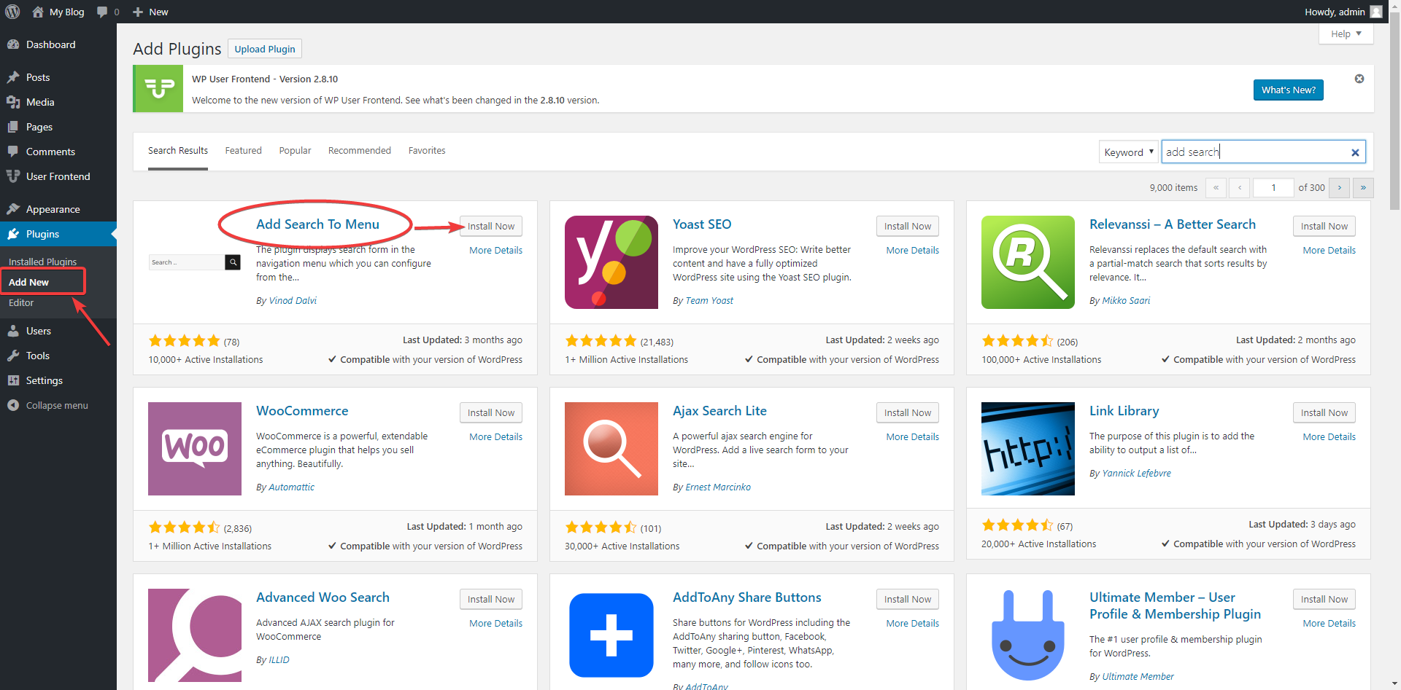
There are more than 59,000 WordPress plugins
The Open-Source Plugin Framework is the Most Critical Factor in its Versatility and Ability to Attract Developers

Slide 34
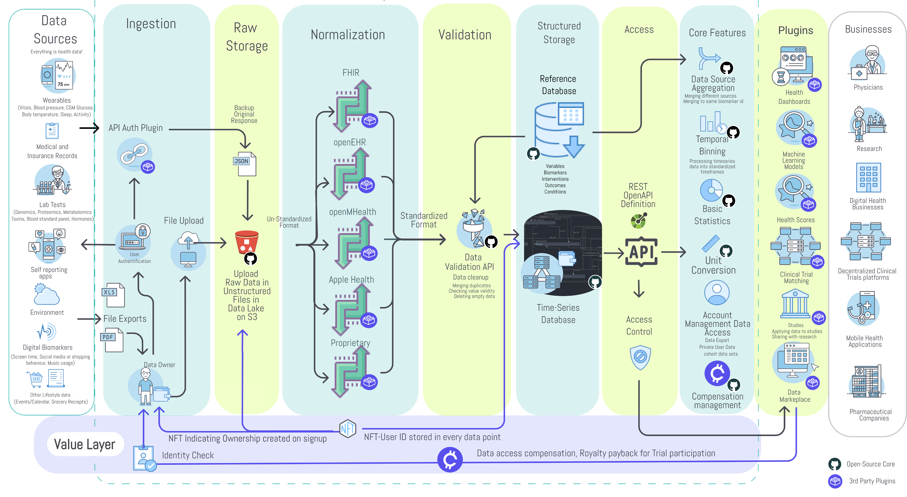

Slide 35
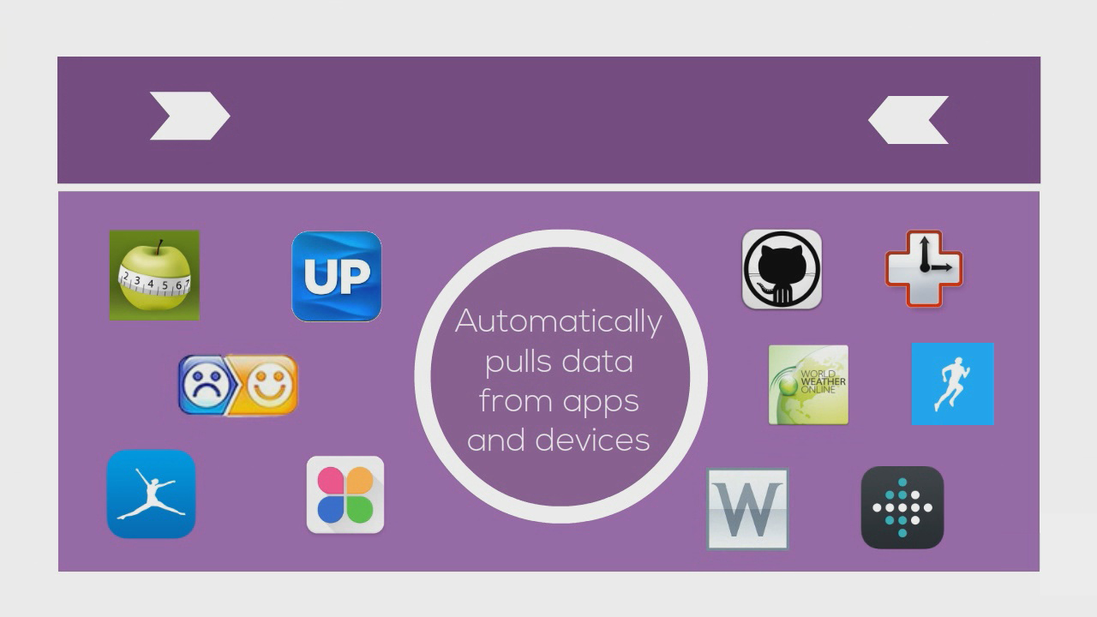

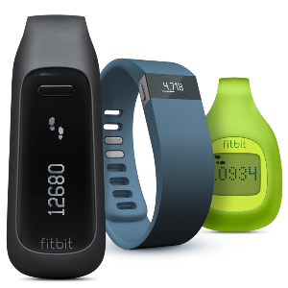


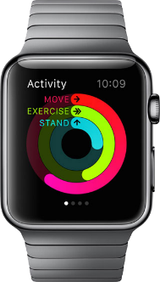

Importer Plugins
Notes:
Move information to left and images on the right.
We also built the QuantiModo Connector Framework, which enabled us to automatically pull passively or actively generated user data from dozens of applications and devices such as Fitbits, Withings scales and blood pressure monitors, and diet data from apps like MyFitnes
The QuantiModo Connector Framework pulls data from dozens of applications and devices such as Fitbits, Withings scales and blood pressure monitors, and diet data from apps like MyFitnessPal.
(Only show most popular ones with names and x more)

Slide 36
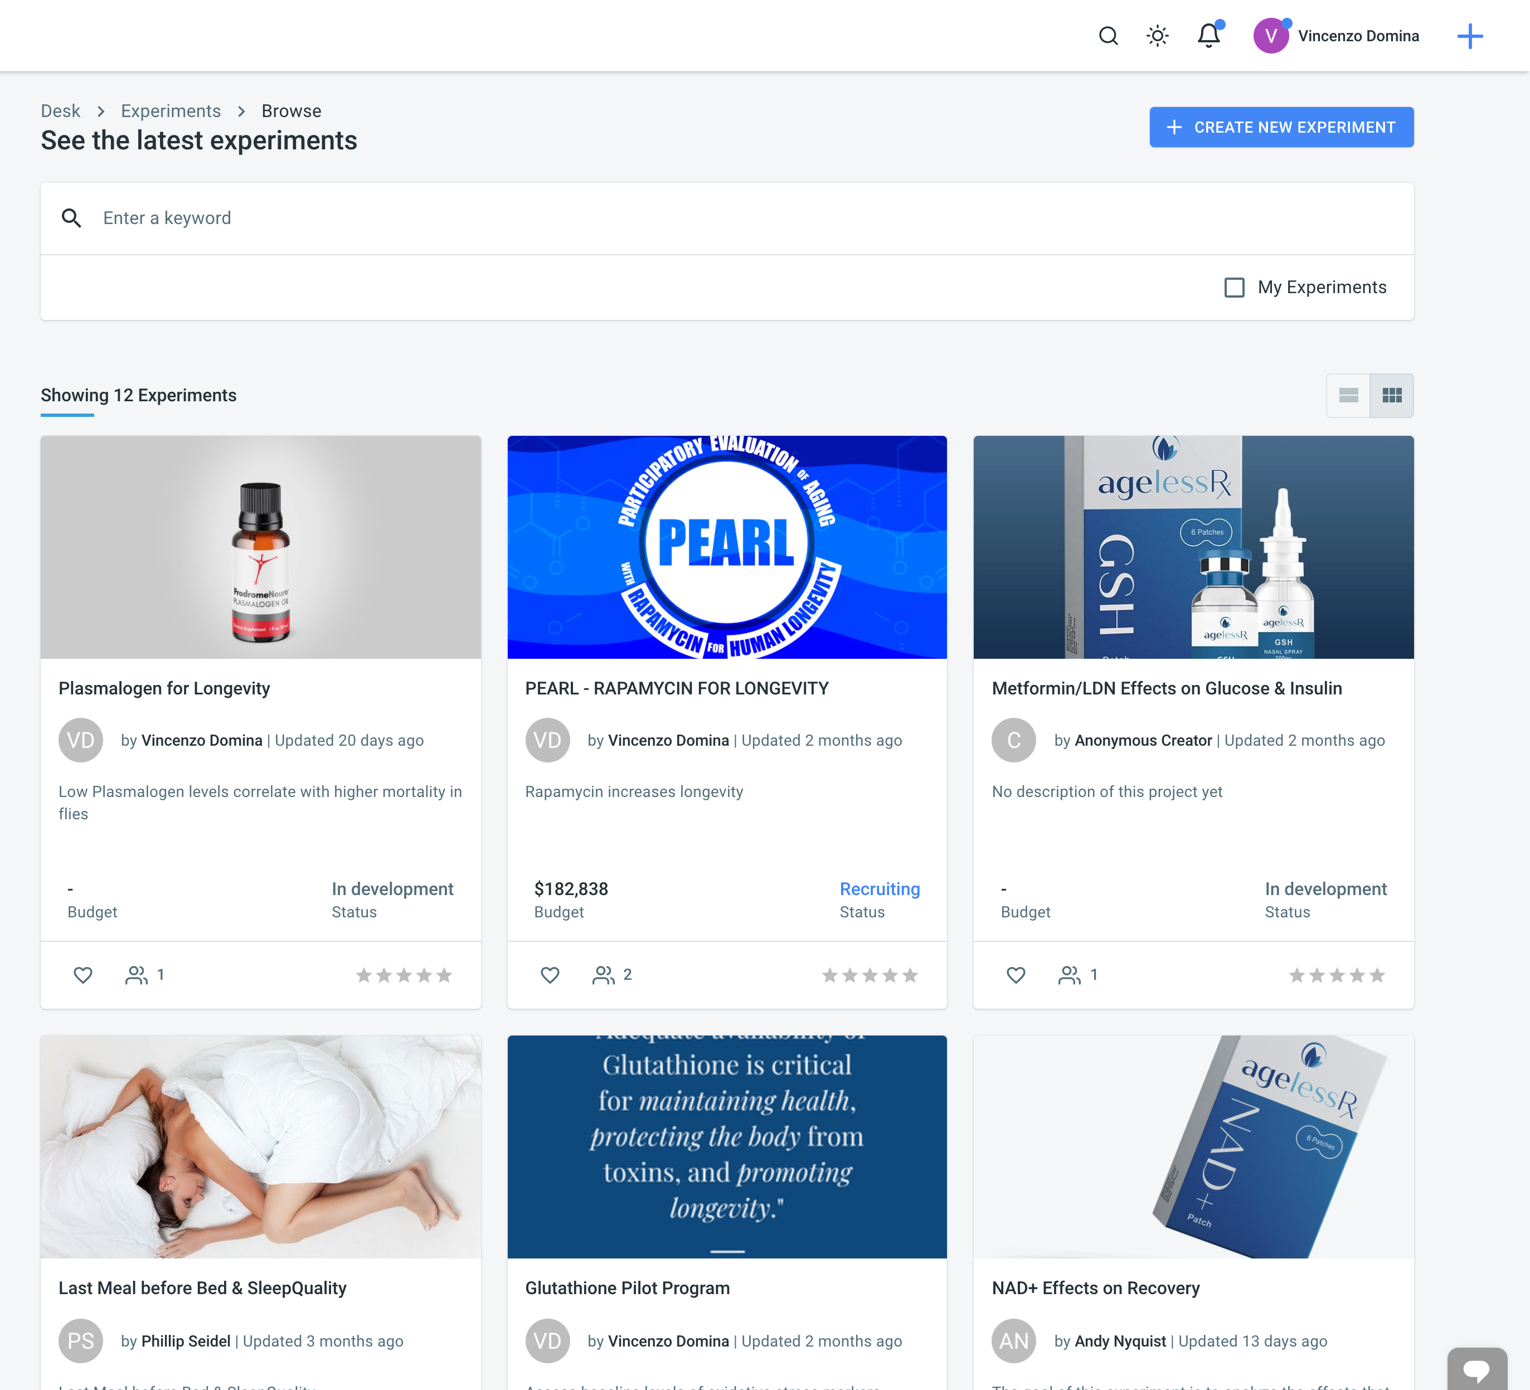
Open Cures Trial Management Plugin

Slide 37
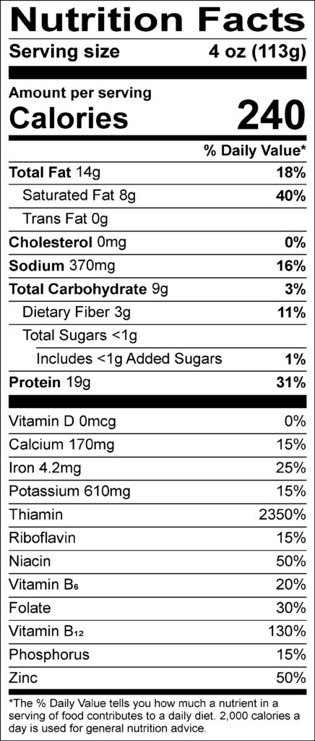
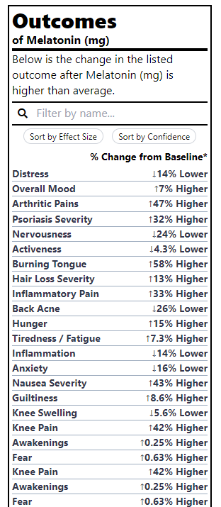
Outcome Labels
It would be far more valuable to know the health effects of different foods than the amount of riboflavin

Slide 38
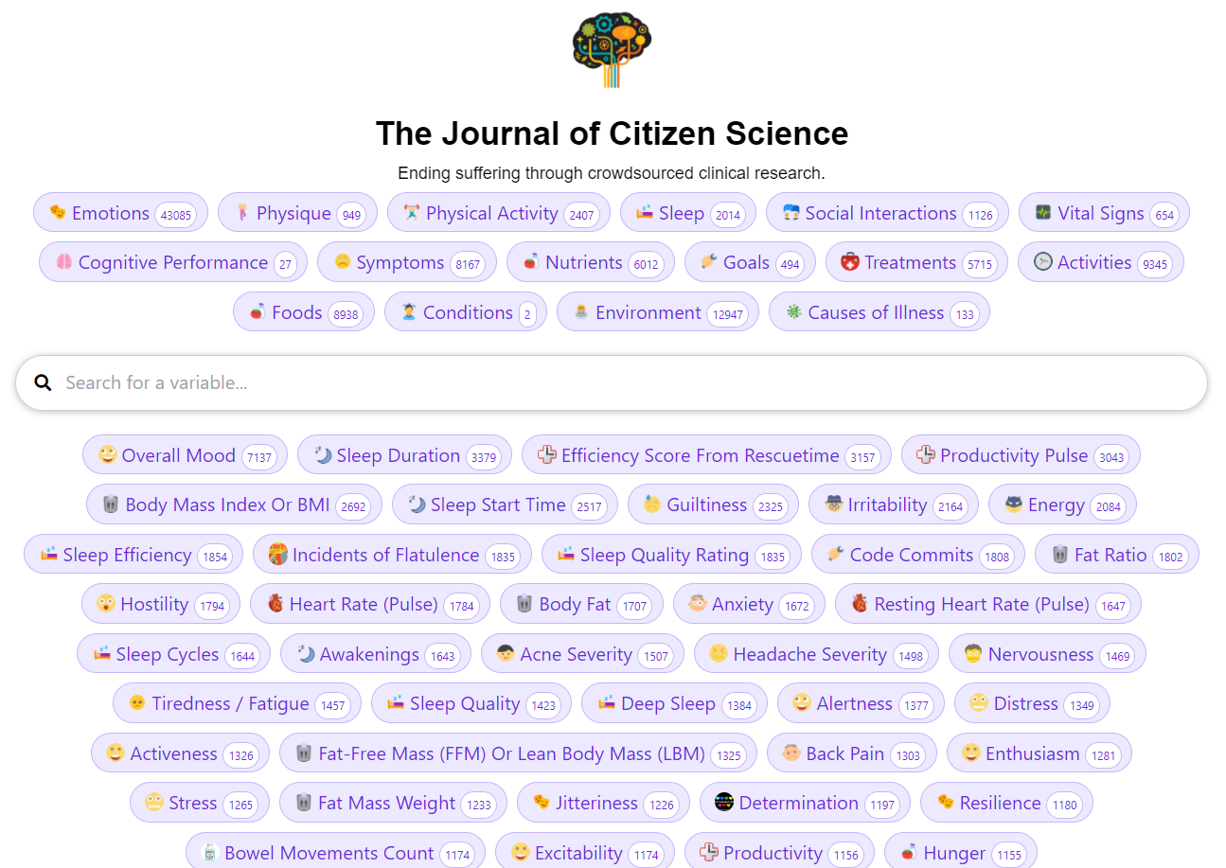
Study Generation Plugins
We’ve created 80,00 studies examining the effects of various factors on symptom severity

Slide 39
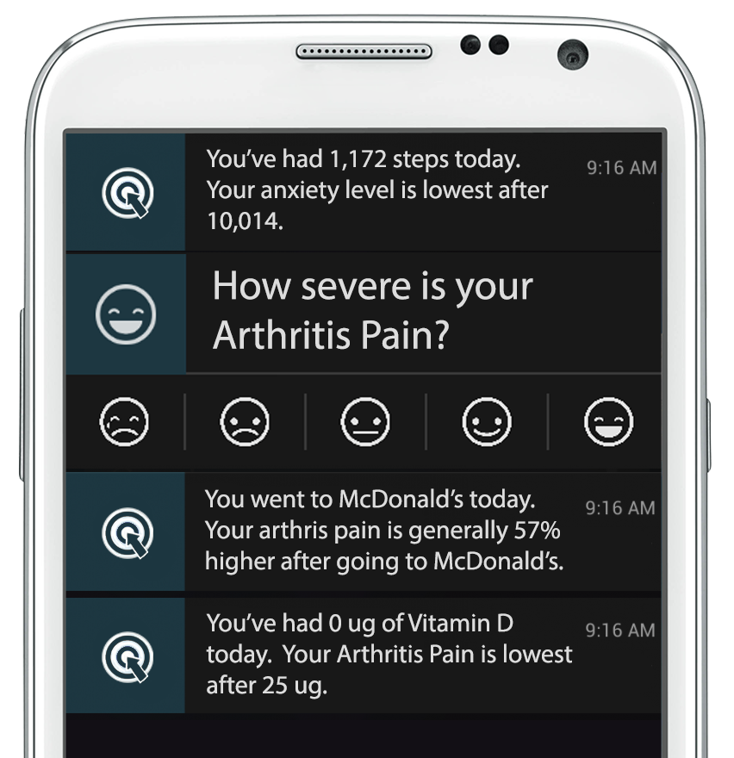
Decision-Support Notification Plugins
Personalized Real-Time Decision Support Informing Individuals of the Most Effective things they can do to treat and prevent disease

Slide 40

Total Addressable Market
613 Million People Track a Health Indicator
x $3 /user/year
= $1.8 Billion TAM
Notes:
We have 6 different segments with 6 different pricing models…
The digital health space has been growing with a massive 50% compound annual growth rate. The healthcare analytics market is a $30 billion dollar industry and includes remote patient monitoring, telehealth, and behavior modification technologies.
Given that Validic and the Human API are already charging about $4 or $5 per year per user. So we believe that $3 per year per user is a competitive price point for us.
613 million people are tracking a health indicator.
$3 per individual per year produces a $1.8 billion dollar total addressable market for QuantiModo.

Slide 41


CLOSED-SOURCE ALTERNATIVES
Company | Price per user per year | Data Aggregation | Open-Source | Plugin Marketplace | Research Platform
 | $5 | ✓ | ✗ | ✗ | ✗
 | $4 | ✓ | ✗ | ✗ | ✗
CureDAO | $3 | ✓ | ✓ | ✓ | ✓
Notes:
Our primary competitors are Validic and the Human API which primarily focus on the aggregation of data from digital health devices. However, they do not provide prebuilt apps, analytics or an end to end solution for researchers.
That market has clearly been validated by recent $12 and $6 million dollar investments in Validic and the Human API this year as well as continued 50% compound annual growthin the the digital health space.

Slide 42

Team Traction
300 Diagnostic Test Customers
10,000 Users in Over 50 Countries
12 Million Data Points Obtained
80,000 Studies Examining the Effects of Factors on Health Outcomes
23 DAO Members
Notes:
We already have 3000 users and 5 million data points with no marketing efforts and have received very positive reviews on the app stores.
90,000 NATURAL LANGUAGE STUDIES ON THE EFFECTS OF VARIOUS FACTORS ON SYMPTOMS OF CHRONIC ILLNESS

Slide 43
Roadmap
Q1/2022 Build the DAO
Create Whitepaper, Website, Media presence, CI
Define collaborators and partners (DAO infrastructure, health data tech)
Setup DAO architecture and infrastructure
Build community, social media content
Fundraising phase (Genesis)
Q3/2022 Integration and Testing
Integrate with other tech architecture (storage providers, data marketplaces, analysis software, etc.)
Integrate with operating health data standards and Electronic Health Record
Build showcase plugins
Release V2 of the Software Framework
Promote broader usage
Q2/2022 Minimal Viable Product (MVP)
Collaborators vote for core features
Build MVP alongside use in showcase trial
Closed Testing with collaborators
Release V1 of the Software Framework
Open Testing with partners
Q3/2023 Minimize time to develop new interventions
Manage personal health to prevent disease
Share health data to research
Get to know new insights
Take newly developed interventions
Educate loved ones about longer health-span

Slide 44
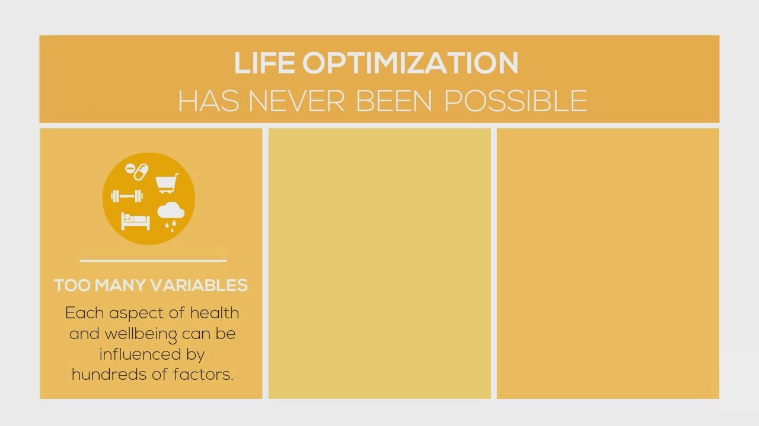
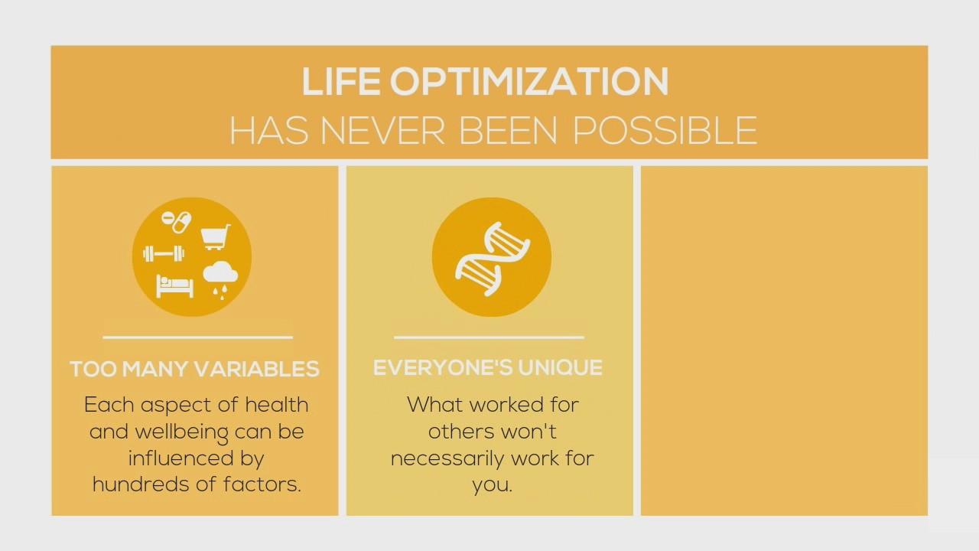
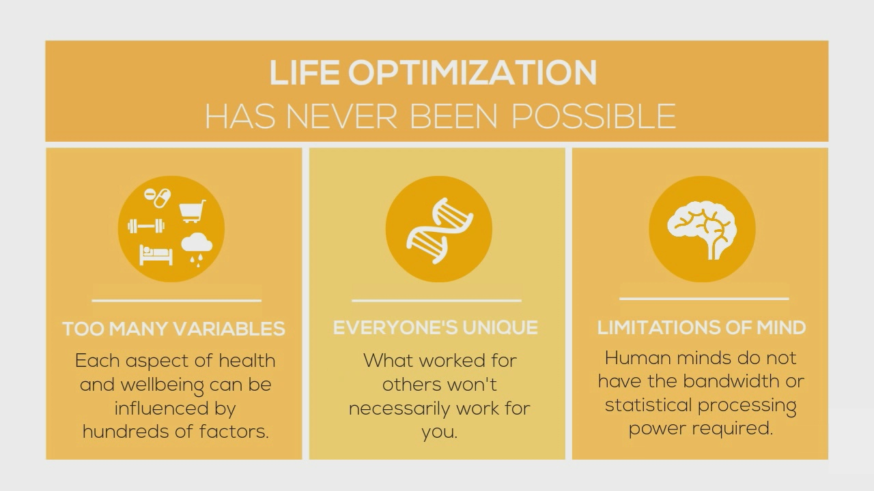
WHY THE CURRENT SYSTEM OF RESEARCH AND TREATMENT IS FAILING
$
COST OF RESEARCH
It costs over $1 billion to bring a drug to market. Clinical trials cost as much as $48k per subject.
LIMITS OF MIND
No doctor’s brain can process all data regarding a patient’s symptoms and influencing factors.
Notes:
THAT’S WHY WE BUILT…

Slide 45
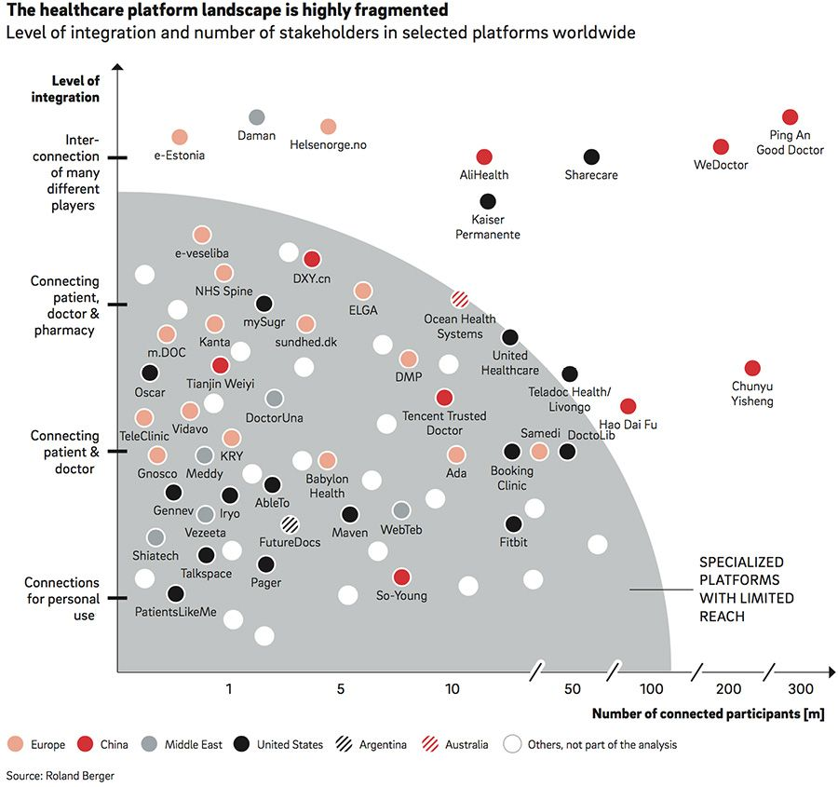
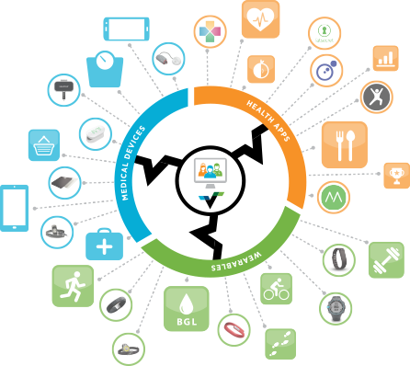

Slide 46
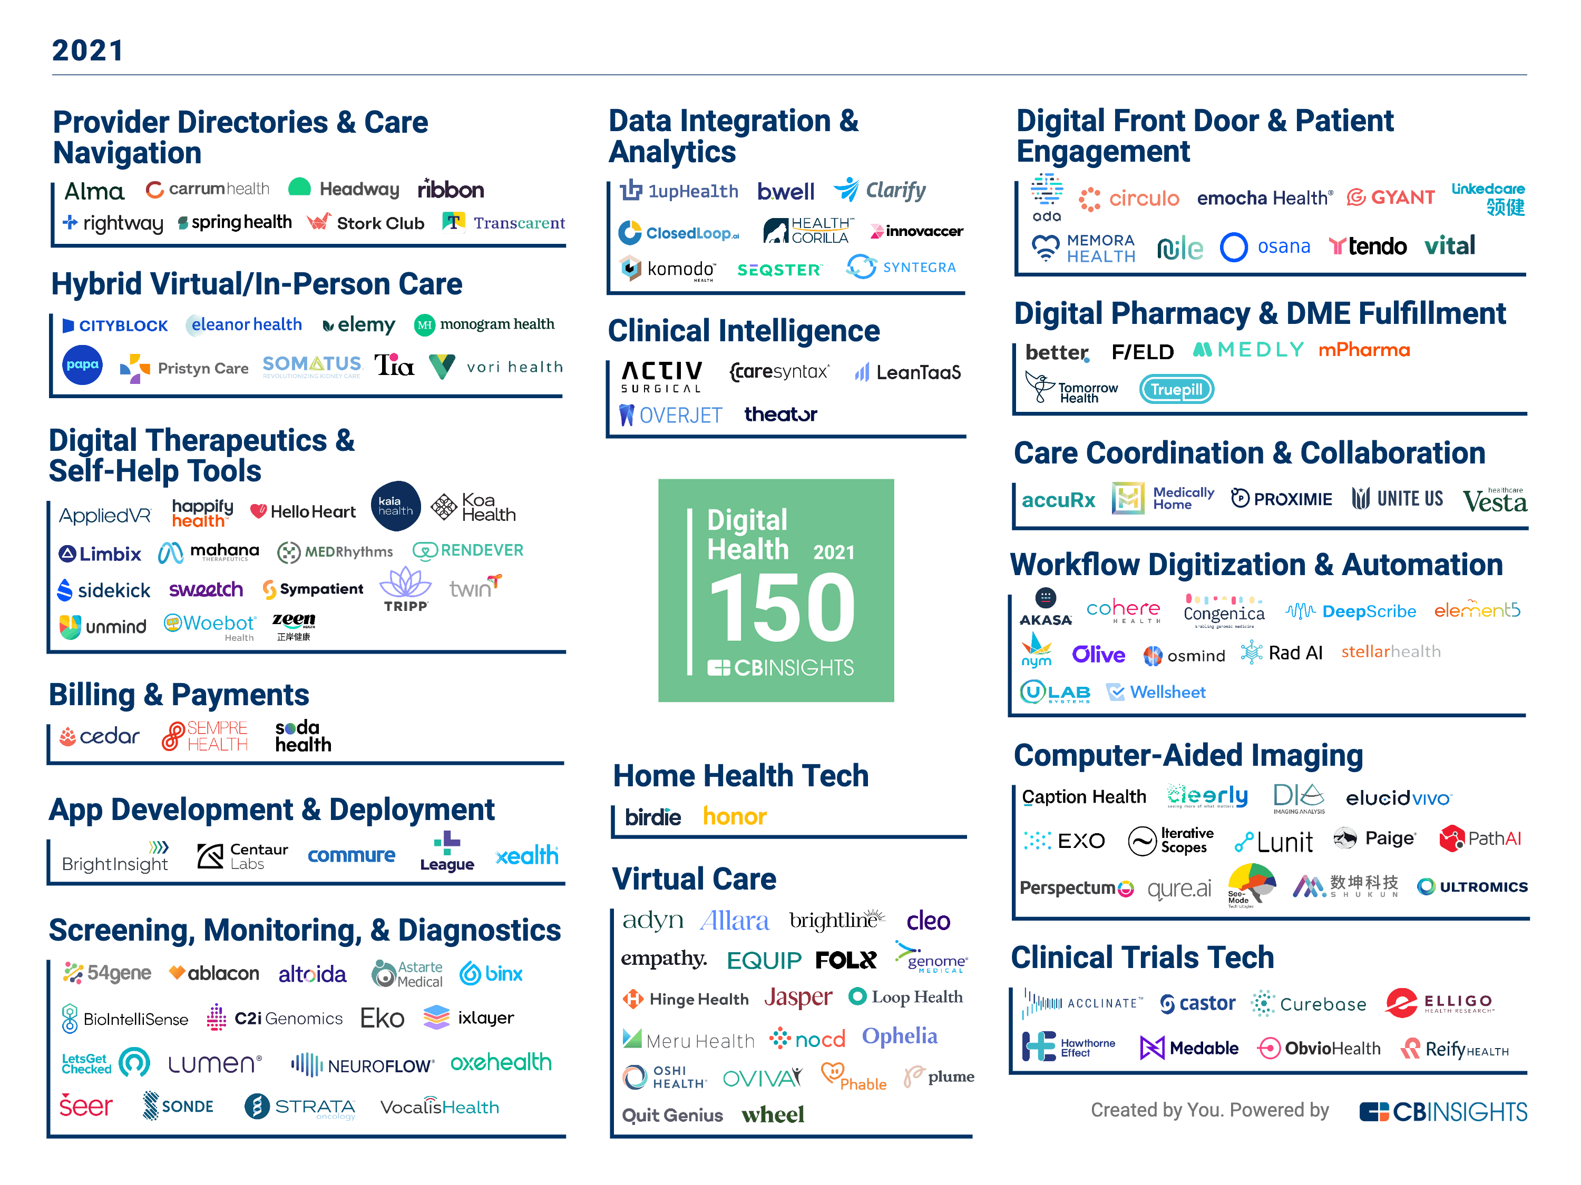

Slide 47
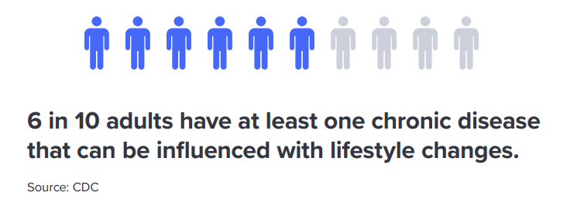

Slide 48





CASE STUDY
Anxiety
Arthritis
Back Pain
Psoriasis
Notes:
I’d like to present my own idiotic immune system, as evidence that the chemicals in our diet have just as significant an impact as those arbitrarily defined “drugs”.
So I worked at an industrial testing lab where we would do root cause failure analyses. During that time, I experienced pretty severe anxiety, psoriasis, and arthritis. It was bad enough in my neck that I couldn’t even turn my head so I was sent to various specialists and took dozens of drugs over the years. And I had to go to physical therapy about 3 times a week.
To better illustrate what an empirical approach to chronic illness looks like, I’d like to briefly tell you about my experience.
I’ve ben using data to solve problems for about 15 years. Initially, I got my degrees in electrical engineering and physics. Then I spent 10 years using various analytical tools and data analysis to solve thousands of industrial problems as the Director of Chemical Testing at St. Louis Testing Laboratories.
At the lab, we would do a lot of root cause failure analysis for different industries. This generally consisted of gathering data, analyzing it, and using it as a basis for research to identify root causes and effective solutions.
During my time there, I developed several health conditions like back and joint pain, psoriasis, and anxiety. My doctor sent me to several specialists who prescribed an array of medications. These were moderately successful at masking the symptoms but they were very expensive and carried several side effects. So I decided to apply the same techniques we used in the root cause failure analyses at my lab to figure out what the hell was wrong with me. REFERENCE
While I was there, I developed several health symptoms including psoriasis, anxiety, and back and joint pain. My doctor sent me to several specialists. The specialists prescribed an array of medications. These were moderately successful at masking the symptoms but they were very expensive and carried several side effects with them. In fact, my Humira prescription costs $25,000 a year.

Slide 49


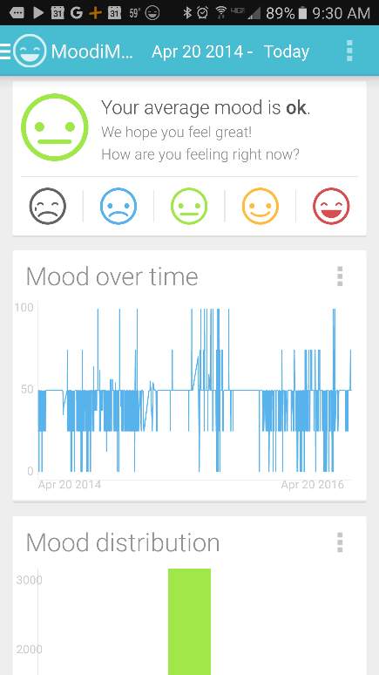
Data Collection
Collect non-automated data on symptoms and all potential factors
Notes:
So I started tracking my symptoms and anything that could influence them with lots of apps and devices. Then I

Slide 50
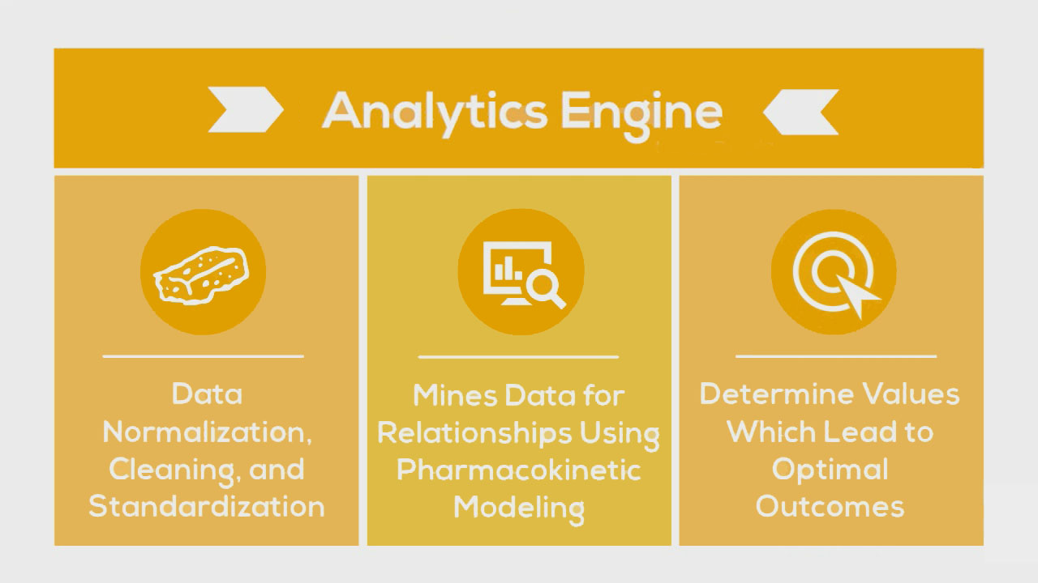
Data Analysis
Notes:
Change yellow background
Slow down here
Once we’ve accumulated all of this data, the Analytics Engine then cleans the data and mines it using pharmacokinetic modeling techniques, which take into account onset delays and durations of action to determine which factors have the strongest influence on a given outcome and what the optimal daily values are.
e.g. Pizza -> might not notice effects until later that day or even gluten sensitivity until a few days later
At this time, we apply coefficients representative of each of [Hill’s criteria for causation](http://www.drabruzzi.com/hills\_criteria\_of\_causation.htm) to quantify the likelihood of a causal relationship between two measures as: * _**Strength Coefficient**_: A relationship is more likely to be causal if the correlation coefficient is large and statistically significant. This is determined through the use of a two-tailed t-test for significance. * _**Consistency Coefficient**_: A relationship is more likely to be causal if it can be replicated. This value is related to the variation of the average change from baseline for other participants with the same treatment outcome variables in conjunction with the variation in average change from multiple experiments in the same individual. * _**Specificity Coefficient**_: A relationship is more likely to be causal if there is no other likely explanation. Relationships are calculated based on other potential predictor variables that were available for the individual over the same time period. The value of the Specificity Coefficient starting at 1 is decreased by the strength of the strongest relationship of all other factors. * _**Temporality Coefficient**_: A relationship is more likely to be causal if the effect always occurs after the cause. * _**Gradient Coefficient**_: The relationship is more likely to be causal if greater exposure to the suspected cause leads to a greater effect. This is represented by the k-means squared difference between the normalized pharmacokinetic time-lagged treatment outcome curves. * _**Plausibility Coefficient**_: A relationship is more likely to be causal if there is a plausible mechanism between the cause and the effect. This is derived from the sum of the crowd-sourced plausibility votes on the study. * _**Coherence**_: A relationship is more likely to be causal if it is compatible with related facts and theories. This is also derived from the sum of the crowd-sourced plausibility votes on the study. * _**Experiment Coefficient**_: A relationship is more likely to be causal if it can be verified experimentally. This coefficient is proportional to the number of times an A/B experiment is run. * _**Analogy**_: A relationship is more likely to be causal if there are proven relationships between similar causes and effects. This coefficient is proportional to the consistency of the result for a particular individual with the number of other individuals who also observed a similar effect.

Slide 51

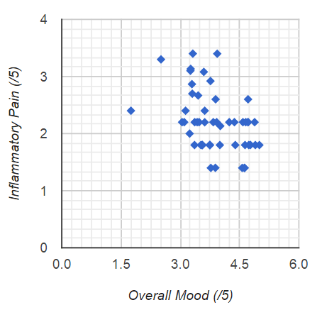
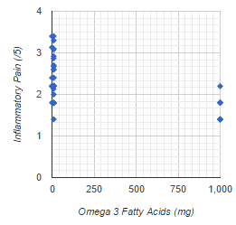
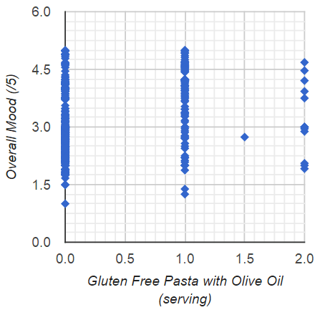

DISCOVERIES
Shared Cause
Anti-Inflammatory
Pro-Inflammatory
Notes:
[Bold text or change yellow background]
The first discovery I made was that the severity of my symptoms correlated very highly with each other, indicating a common underlying root cause. And another discovery was that increased severity was most strongly correlated with prior gluten and sugar intake. So, all these separate conditions were just symptoms of the same underlying root cause. That root cause is an inflammatory immune reaction caused by dietary factors. So, I removed those from my diet and within a couple of weeks or so nearly all the symptoms that I had been dealing with for years went into near-complete remission.
When I first started doing this, all this tracking, data aggregation, and analysis were extremely arduous, so a few years ago, I started working on a platform called QuAnTiMoDo to make it easy enough for anyone else to use this empirical approach to manage their condition.

Slide 52

Self-Quantification
Notes:
I decided to start apply the same techniques that we used at my lab to identify the root cause of my symptoms. So I started tracking symptoms and influencers with a bunch and apps. I then exported the data to a bunch of spreadsheets and analyzed it.

Slide 54
Business Model
Collaborate with the 350,000 existing health apps and platforms to increase value for their users.

